Slide 1


Parameterized Synthesis for Distributed Applications with Consensus
Nouraldin Jaber
Swen Jacobs
Milind Kulkarni
Roopsha Samanta

Slide 2
Correct Distributed Systems Are Hard To Build
Complex building blocks
Consensus
Atomic commit
Reliable broadcast
…
Padon et al. 2017
Chand et al. 2016
Dragoi et al. 2016
Wilcox et al. 2016
Cousineau et al. 2012
Lamport 2002
…

Slide 3
Correct Distributed Systems Are Hard To Build
System should be correct for any number of processes
Notes:
Just because a system is correct for 3 processes doesn’t mean it’s correct for 10! Hence, Line1

Slide 4
Correct Distributed Systems Are Hard To Build
System should be correct for any number of processes
Parameterized
parameterized verification
Notes:
Just because a system is correct for 3 processes doesn’t mean it’s correct for 10! Hence,
Line1
In other words distributed systems are Parameterized over the number of processes, which calls for parameterized verification procedure where we check correctness for any number of processes

Slide 5
Correct Distributed Systems Are Hard To Build
Programmers need help building such systems
So many moving parts!
Synthesize parts of the system
Notes:
But verification is not adequate
Line 1
It would be nice if we can .. Line2

Slide 6
DisCoVer[i]
Challenges
Solutions
Complex building blocks
Abstractions
Correct for any number of processes
Deciding parameterized verification
Programmer assistance
Parameterized synthesis
Notes:
Component-based parameterized verification and synthesis of distributed systems.

Slide 7
This Talk
Systems with Consensus components
Abstractions
Deciding parameterized verification
Parameterized synthesis

Slide 8
The Basic Model
Hi!
P₁
P₂
Identical FSMs
Global Transition System
Interleaving semantics
Communication actions
Point-to-point
Broadcasts
A
B
C
A
B
C
Hi?
A A
A B
B A
Hi
…
…
C A
C A
…
…

Slide 9
This Talk
Systems with Consensus components
Abstractions
Deciding parameterized verification
Parameterized synthesis
Notes:
Now let us start by introducing an abstraction for consensus

Slide 10
Consensus Protocols
participants
,
)
=
{
}
cons(
{1, 2, 4}
2
{1, 2}
,{1, 4} ,{2, 4}
cardinality
winners
Notes:
What is the point of a consensus protocol?
at its core, consensus boils down to choosing a subset of winners (or winning proposals) from the set of participants in a way that is globally consistent.

Slide 11
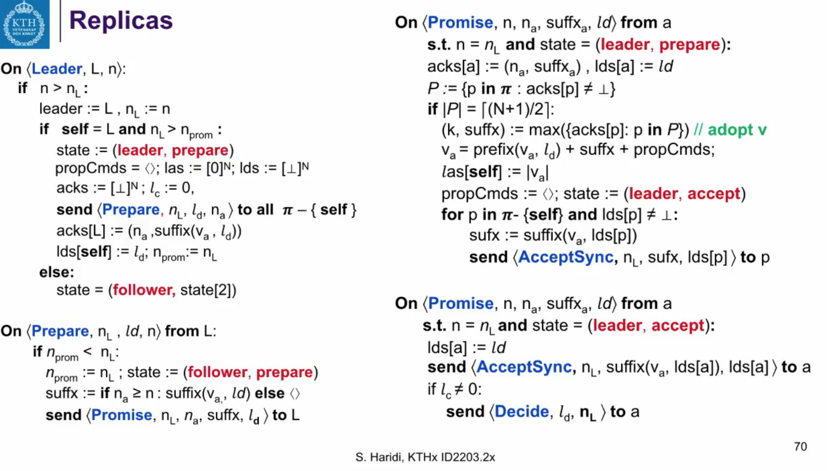
cons({1,2,4} , 2) = { {1,2} , {1,4} , {2,4} }
C C X C
choose
Abstract
+
Primitive
Specification
Consistent Participants
Consistent Winners
C C X C
winners
loser
Notes:
Say what C C X C means
Explain the color code
Say why do we need the axioms
A specifications that makes sure this primitive faithfully represents a consensus protocol

Slide 12
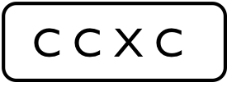
cons({1,2,4} , 2) = { {1,2} , {1,4} , {2,4} }
C C X C
$$\text{C} \text{C} \text{X} \text{C}$$
atomic
choose
non-deterministic
C C X C
C C X C
C C X C
C C X C
...
...
...
winners
loser
12
Notes:
Highlight: non determinism, atomicity, global transition
Conclude: that was the primitive, what about the axioms? *click*

Slide 13
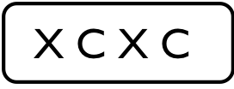
$$\text{X} \text{C} \text{X} \text{C}$$
cons({1,2,4} , 2) = { {1,2} , {1,4} , {2,4} }
C C X C
Consistent Participants
$$\text{C} \text{C} \text{X} \text{C}$$
atomic
choose
non-deterministic
C C X C
Consistent Winners
C C X C
C C X C
C C X C
...
...
...
winners
loser
Notes:
Explain consistent participants:
Each participating process agrees on who to reach consensus with
Consensus round is started when all the participants are ready,
Say why X C X C isn’t consistent: process P1 isn’t yet in the right state.
Consistent Winners
When the consensus round ends, each participant will have a local result that is globally consistent with all other participants.
Say that a state where all processes won, isn’t good!
recap, say pre and post about the conditions

Slide 14
This Talk
Systems with Consensus components
Abstractions
Deciding parameterized verification
Parameterized synthesis
Notes:
Now let us start by introducing an abstraction for consensus

Slide 15
Extended model
Basic model
+
choose transitions
Can we verify parameterized systems under this model?
Notes:
Say that it’s the basic model plus the choose primitive
Can we prove decidability of the verification problem for such extended model?
Introduce the second part.

Slide 16
Parameterized Model Checking Problem
Goal: Check correctness for any number of processes
Undecidable, in general
Obtain decidability by restricting:
Communication primitives a process can use
Network topology of the system
Supported specification language
Notes:
Usually, these results restrict the verification problem
in at least three dimensions: i) the communication primitives a process can
use, ii) the network topology of the system, and iii) the supported
specification language.

Slide 17
Parameterized Model Checking Problem
Goal: Check correctness for any number of processes
Undecidable, in general
Obtain decidability by restricting: [Esparza et al. 1999]
Communication primitives a process can use Broadcasts
Network topology of the system Clique
Supported specification language Safety properties only
Notes:
{EsparzaFM99} showed that for i) (instantaneous)
broadcast communication ii) in a clique, one can decide iii) safety properties
of one or more processes (while liveness properties are shown to be
undecidable).

Slide 18
Parameterized Model Checking Problem
However none of the existing decidability results subsumes extended model with the choose primitive
Proof idea: Reduce to Well-Structured Transition Systems
Parameterized verification of safety properties is decidable for the extended model
Notes:
While the Esparza model is close to that we want, it does not totally subsume the extended model

Slide 19
This Talk
Systems with Consensus components
Abstractions
Deciding parameterized verification
Parameterized synthesis
Notes:
Now let us start by introducing an abstraction for consensus

Slide 20
Specifications
Process FSM
Specifications
Process Sketch
Parameterized Verification
Parameterized Synthesis
System is correct for any number of processes n?
Complete process FSM such that system is correct for any n

Slide 21
Parameterized Synthesis
Parameterized Verifiers
Cut-off results
Notes:
Two directions for parametrized synthesis:
Parametrized model checker
Cut-off results
To understand how these two approaches work, first let us talk about a standard process for synthesis for a fixed number of processes.

Slide 22
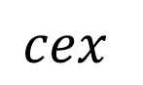
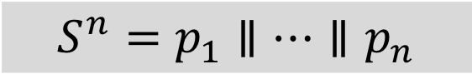
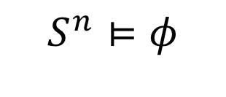
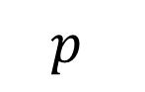
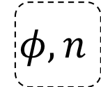
Synthesis For a Fixed # of Processes
$$S^{n}⊨φ$$
$$p$$
Verifier
$$cex$$
Synthesizer
no?
No completion
ok?
$$φ, n$$
$${S^{n}=p}_{1}∥…∥p_{n}$$
Success
Notes:
Normal CEGIS

Slide 23
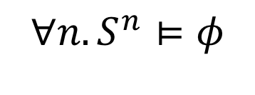
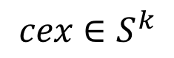
Synthesis For Any # of Processes
$$S^{n}⊨φ$$
$$p$$
Verifier
$$cex$$
Synthesizer
no?
No completion
ok?
$$φ, n$$
$$∀n. S^{n}⊨φ$$
Parameterized Verifier
$cex$ $∈S^{k}$
$${S^{n}=p}_{1}∥…∥p_{n}$$
ok?
Success
Notes:
Two-loop approach

Slide 24
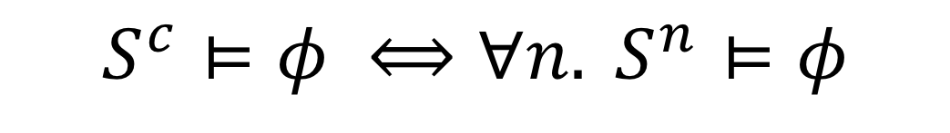
Cut-offs
For some systems, a cut-off value c exists such that
$$S^{c}⊨φ ⟺∀n. S^{n}⊨φ$$
Derived cut-off values for certain classes of systems that use choose
Notes:
Directly reduces both parameterized verification and synthesis to a problem over a fixed number of processes
“an error state is reachable with any number n ≥ c of processes if and only if it is reachable with c processes.”

Slide 25
Implementation and Evaluation
Extended the Kinara framework
Derived cut-offs and synthesized a number of examples
Smoke detectors, SATS, Chubby cells, …
Notes:
Which is a framework to synthesize for a fixed number of processes.

Slide 26
Future Directions
Consensus in presence of failures
Liveness properties
Other distributed components
Atomic commit
Reliable broadcast
…

Slide 27

DisCoVer[i]
Systems with Consensus components
Jaber
Jacobs
Abstractions
Deciding parameterized verification
Kulkarni
Samanta
Parameterized synthesis
Notes:
Component-based parameterized verification and synthesis of distributed systems.

